Slide 1



Digital systems
Led by: Professor. Arnesh Telukdarie
Johannesburg Business School
November 2022

Slide 2


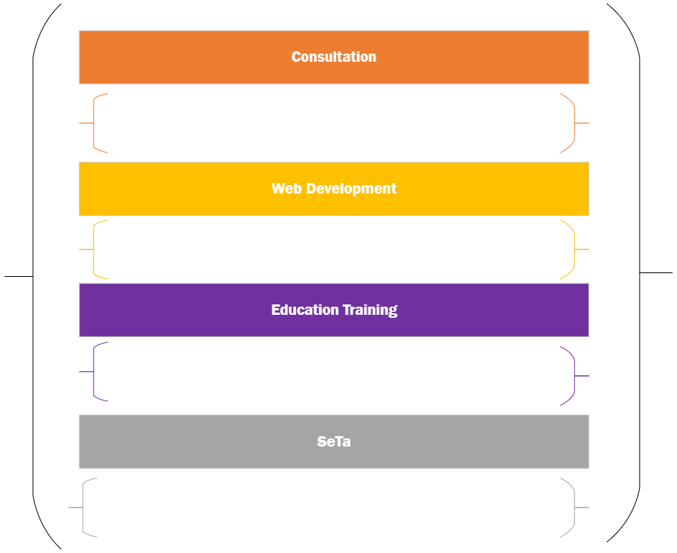
Projects

Slide 3


Consultation

Slide 4
Joburg Water

Slide 5

Joburg water project
Water and Chemistry
Water And Nanotechnology
Water and Digital/ Business
Water and Energy
PEETS: Process Energy and Environmental Technology Station
Water and Health
Water and Chemical Engineering
Water and Biological Science
Purification
1
Energy
Chemicals
Distribution
2
Energy
Energy
People
Time
Finances
Equipment
People
Time
Finances
Equipment
Wastewater Management
3
People
Time
Finances
Equipment
Chemicals

Slide 6
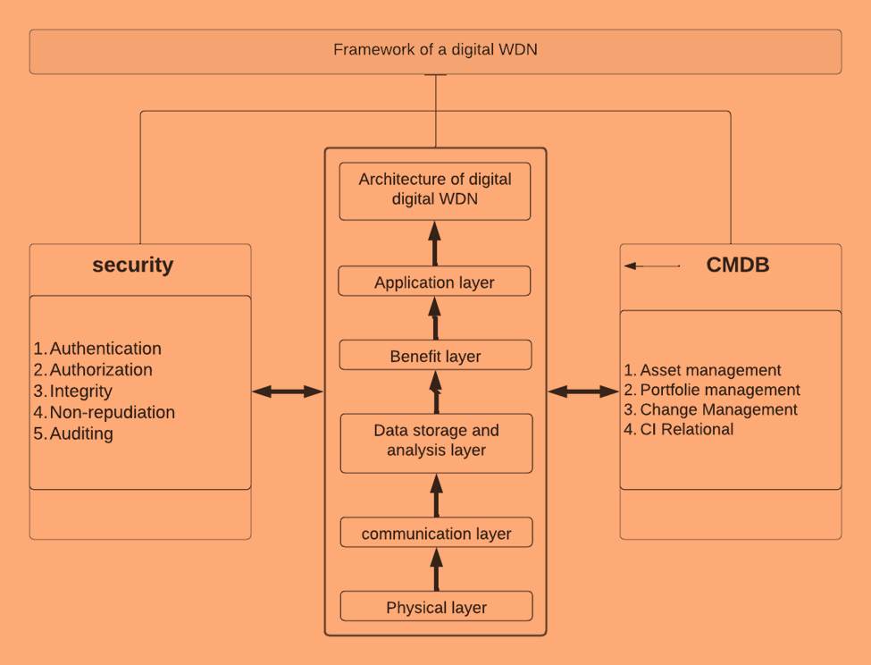
The 4IR Framework for Water Distribution Network
Big data
Smart sensors
Advanced data analytics
Machine learning
AI
Robotics
Digital Twin
Cyber-physical systems
Internet of Things

Slide 7
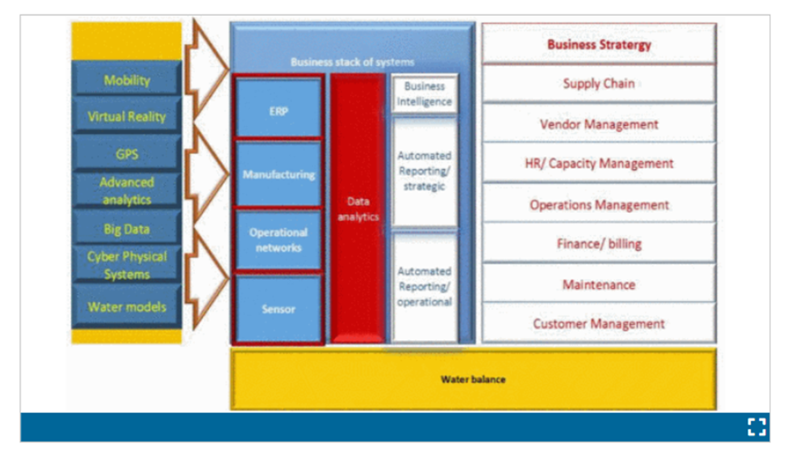
Joburg Water Integrated Business Model
Effective water digitalization drives alignment and integration which improves combined water infrastructure or related processes; enables integration and management of horizontal and vertical value chains in enterprise operations; and requires interface amongst applied systems premised on highly specialized user interface and software combined into digital networks, to formulate entirely new system functionality platforms.

Slide 8
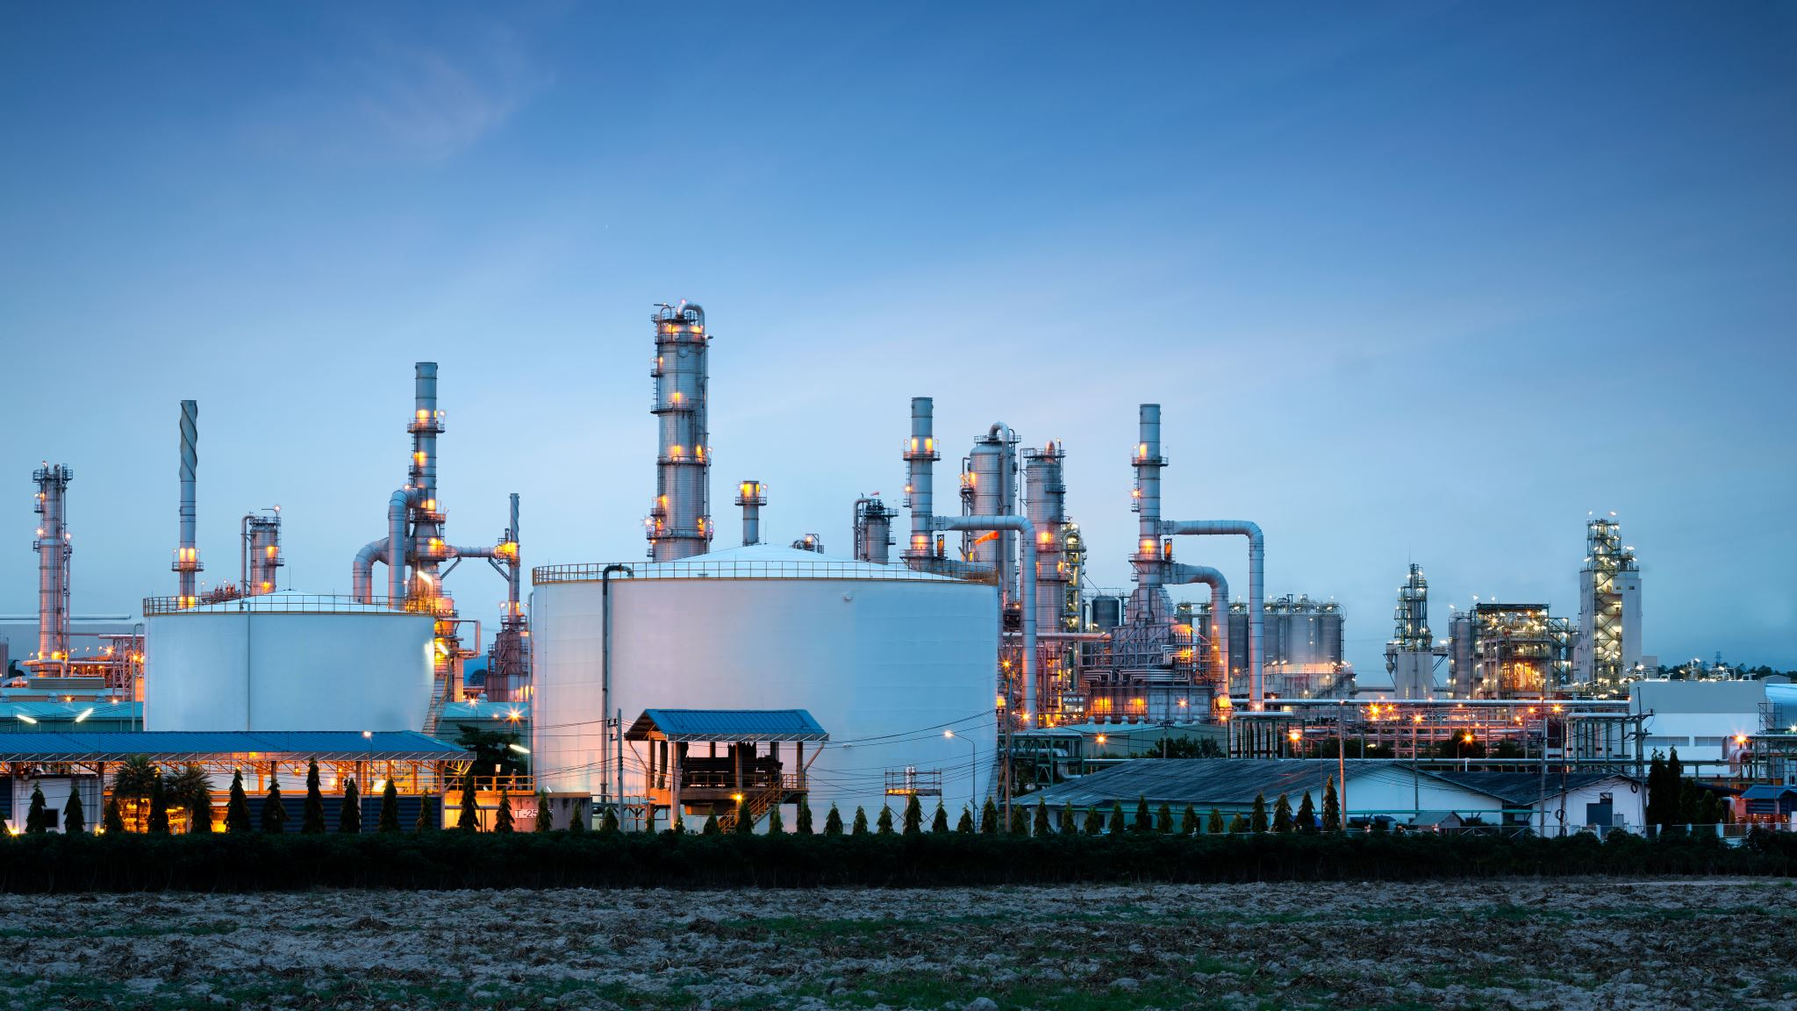
Rand Refinery

Slide 9
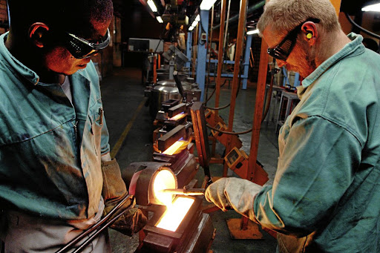
Rand refinery Digital Maturity Consulting
“Digital Transformation Roadmap for Rand Refinery”
The aim of the project was to produce an all inclusive, visionary roadmap for the implementation of business-wide integrated digital systems.
The scope of works for the project included the integration and optimisation of systems for total enterprise, including all aspects of the planning, domestic and international supply and distribution chains, plant operations as well as support functions.

Slide 10
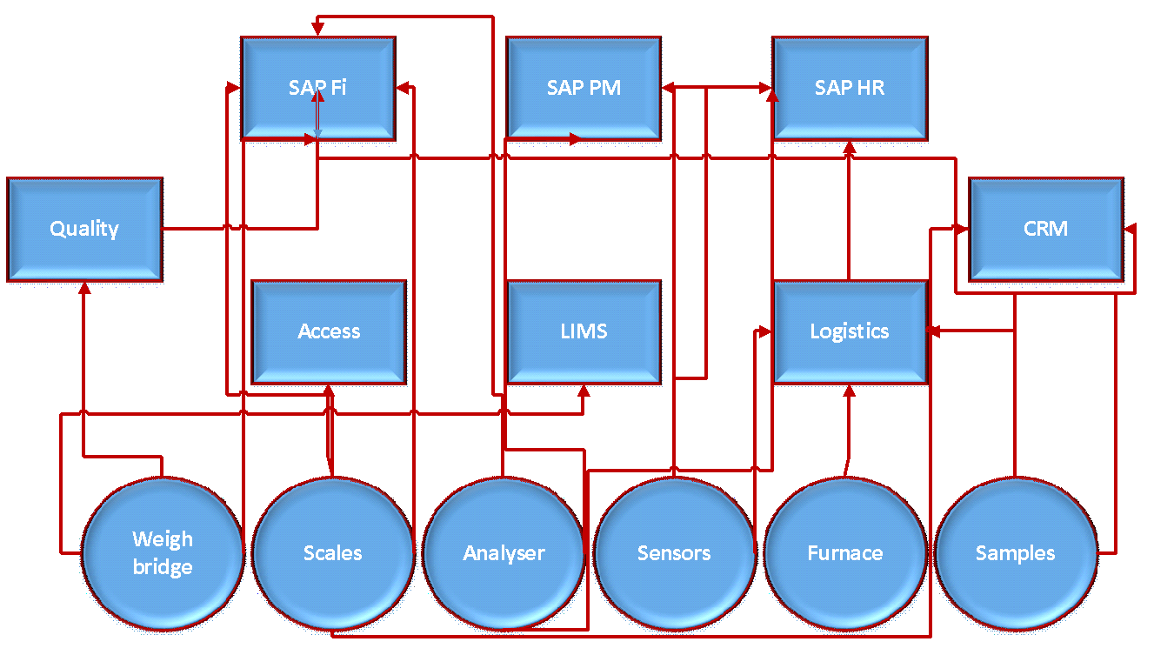
Spaghetti Integration of Standalone Business Systems

Slide 11
Rand Refinery (Systems integration)
Integration of different business layers for automated workflow.

Slide 12
Data reporting and workflow (Rand Refinery)

Slide 13

Education and Training

Slide 14


Work Readiness Programme

Slide 15
Accenture and UJ collaboration: Work readiness program for postgraduate students
The Advanced Technology Centre is located in Devland (Soweto).
The project provides training to students in various subjects.
The collaboration is inspired by the fact that both UJ and Accenture have aspirational goals and a vision for addressing unemployment.
The project is also part of UJ and Accenture’s drive to develop an innovative business model.

Slide 16

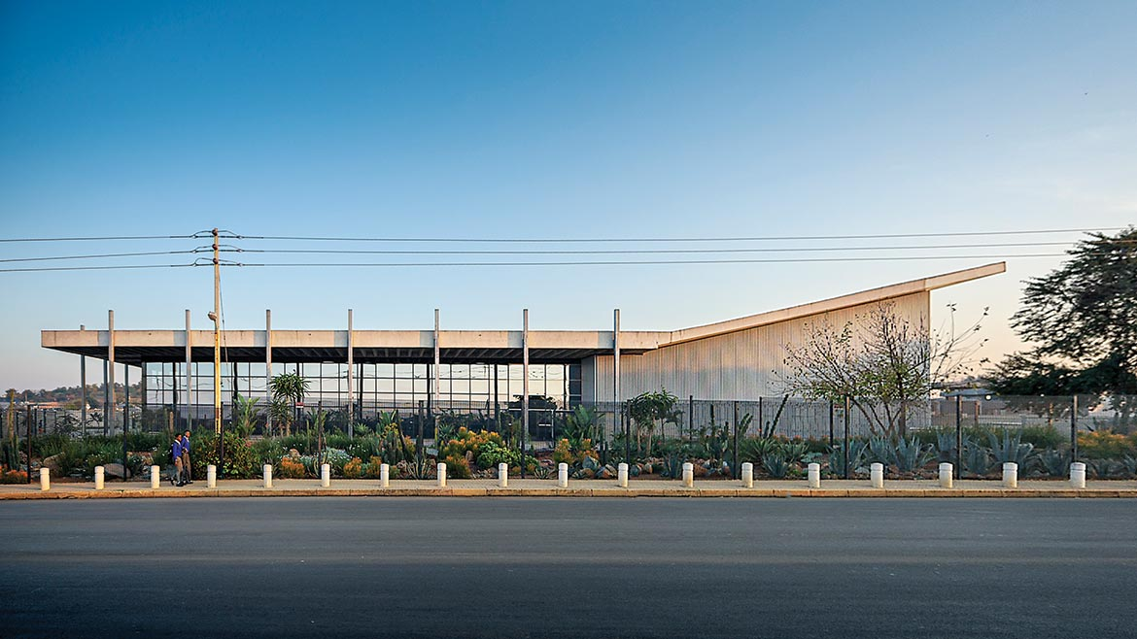
UJ & Accenture – Work Readiness Programme

Slide 17
Accenture and UJ collaboration: Work readiness programme.
4IR Technologies
Engineering Business Systems in 4IR
Subject areas
In two years, the programme has trained over 250 postgraduates in the listed subject areas.
Agile Rapid Skills Acquisition
Full Stack Web Development

Slide 18

SETAs

Slide 19

Food and Beverage SETA and UJ collaboration in SME development
The project is a collaboration between UJ, and FoodBev seta is providing digital skills for SMEs
The project provided training for 225 SMEs on digital transformation processes with respect to key business functionalities.
The project developed 10 systems identified as a need for SME digital transformation currently under testing.

Slide 20
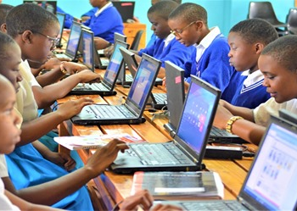
Bank Seta Project – Rural development
“Skills for the future”
This BANKSETA-sponsored project, in partnership with the University of Johannesburg, aims to introduce digital technologies in rural schools.
Grade 12 learners from rural schools are trained on 4IR technologies.

Slide 21

FoodBev SETA Data Analysis

Slide 22
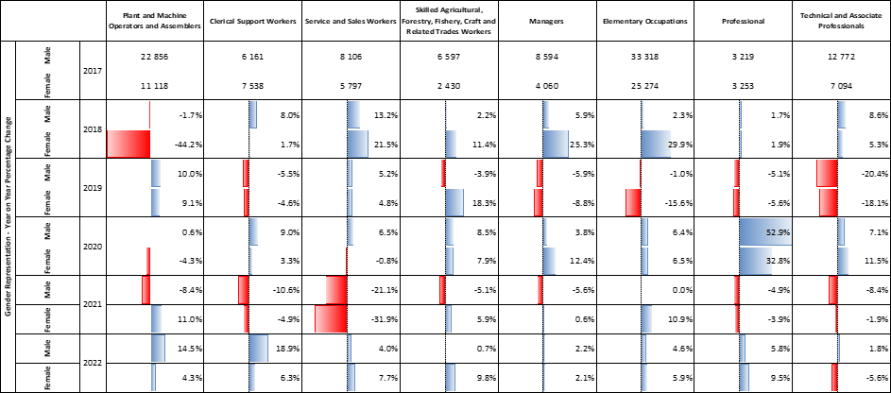
FoodBev SETA Data Analysis
EMPLOYMENT BY GENDER AND OCCUPATIONAL GROUPS.

Slide 23
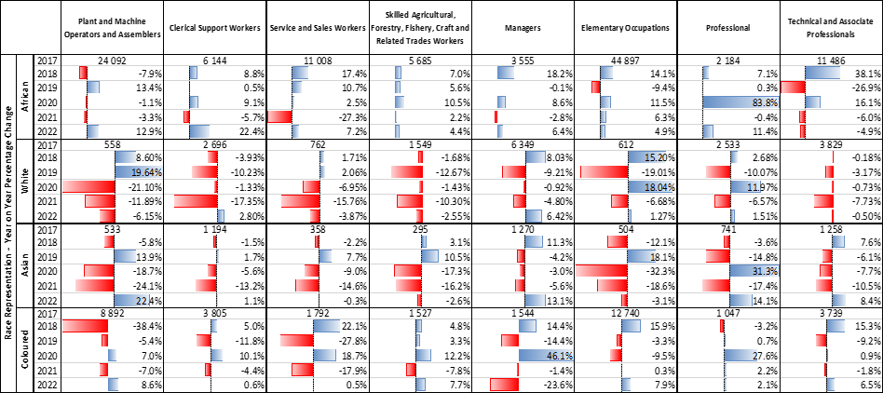
Employment Rate: Race – Major Occupation

Slide 24
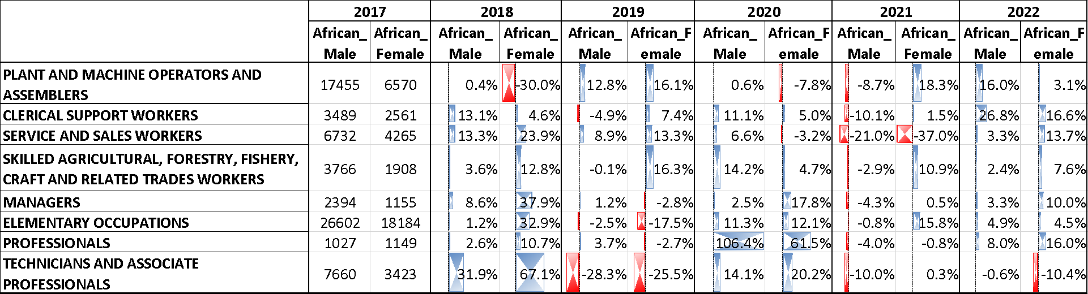
Top 10 Major occupation for African Male & Female

Slide 25
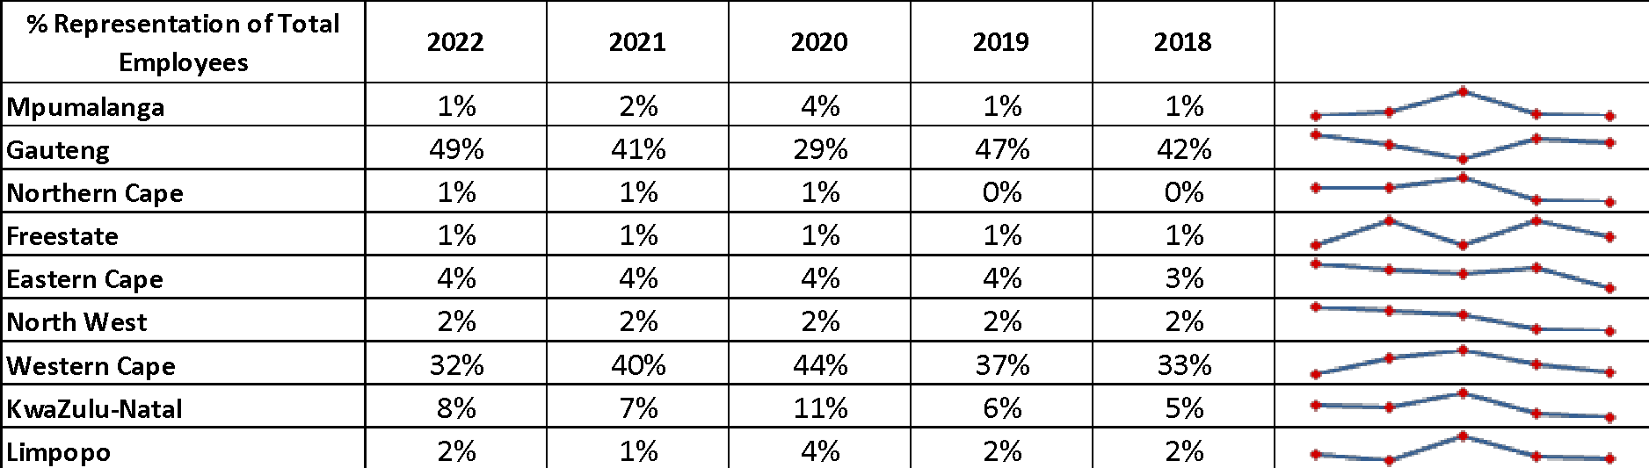
Employee Distribution Across 9 Provinces

Slide 26
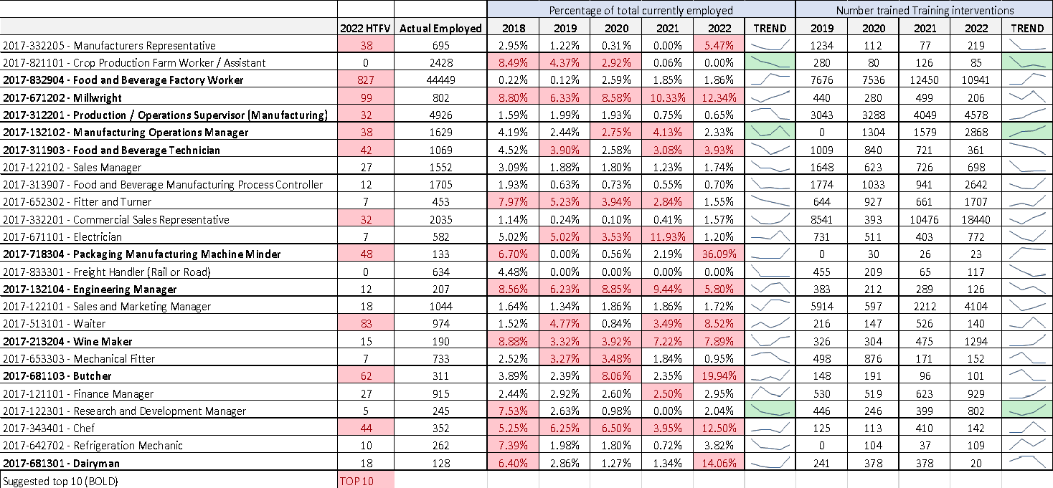

Slide 27

Smart Systems & Applications

Slide 28

Applications Developed For SMME: FoodBev
Invoice generator
Business Case
DIY Website
Marketplace/Order management
Digital marketing
International marketing
Auto-marketing
Email marketing

Slide 29
The End

